Slide 1
Welcome! Database Development and Design
Developing and Design of databases using SQL Server

Slide 2
Agenda
Session 1
Session 2
Session 3
Session 4
Session 5
Homework discussion
Stored procedures
Workshop
Error handling
Workshop
Basic administration
Backups
Permissions
Knowledge check (Quiz, Discussion, Homework)
Summary

Slide 3
Homework discussion

Slide 4
Stored procedures

Slide 5
Stored Procedures 1/4
A T-SQL stored procedure consists of a single batch of T-SQL code. Stored procedures have a number of important features, such as the following:
They can be called from T-SQL code by using the EXECUTE command.
You can pass data to them through input parameters, and receive data back through output parameters.
They can return result sets of queries to the client application.
They can modify data in tables.
They can create, alter, and drop tables

Slide 6
Stored Procedures 2/4 - Advantages
Using T-SQL stored procedures in a SQL Server database has a number of advantages, such as the following:
To encapsulate T-SQL code
To make a database more secure
To help improve performance by creating execution plans that can be reused

Slide 7
Stored Procedures 3/4 - Declaration
CREATE PROCEDURE ProcedureName (@ParaleterList [datatype])
AS
BEGIN
DECLARE @Variable1,..N [datatype]
-- Insert statements
-- Update statements
-- Delete statements
-- Temp tables / Table variables
-- Output statements (0,1,2,..) – multiple resultsets
Select Columns
FROM Table1,...TableN
END
Session 5 – 00 StoredProcedure.sql

Slide 8
Stored Procedures 4/4 - Example
Create procedure for adding new customer
As output from the procedure return the following data:
Total number of customers starting with the same character as the new customer
Additionally in second resultset return how many customers already exist in the new customer region
Session 5 – 01 Stored procedure demo.sql

Slide 9
Stored procedures – Workshop 1/2
Create new procedure called CreateOrder
Procedure should create only Order header info (not Order details)
Procedure should return the total number of orders in the system for the Customer from the new order (regardless the BusinessEntity)
Procedure should return second resultset with the total amount of all orders for the customer and business entity on input
Insert few orders in the system

Slide 10
Stored procedures – Workshop 2/2
Create new procedure called CreateOrderDetail
Procedure should take the single price for item from Product table (Price column)
Procedure should add details for specific order (new record for new Product/Quantity for specific order)
When the order detail is inserted procedure should correct the TotalPrice column in the main table (dbo.order)
Output from this procedure should be resultset with order details in a form of pairs: ProductName and TotalPrice per product (Price*Quantity)
Insert few order details for some orders
Session 5 workshop - 01 Stored Procedures.sql

Slide 11
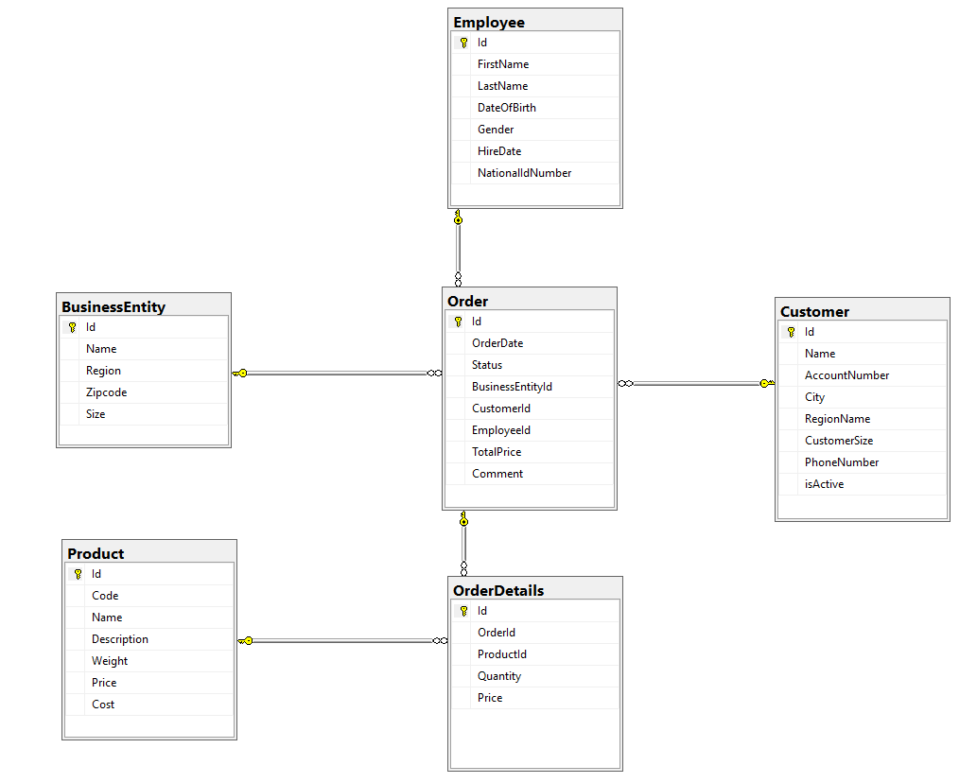
Have the structure of tables in mind
when creating the procedures

Slide 12
Error handling

Slide 13
TRY … CATCH
BEGIN TRY
{ sql_statement | statement_block }
END TRY
BEGIN CATCH
[ { sql_statement | statement_block } ]
END CATCH
https://docs.microsoft.com/en-us/sql/t-sql/language-elements/try-catch-transact-sql
Very useful when you want to handle Error messages. Usually used in Stored procedures and Triggers.

Slide 14
Retrieving Error Information
In the scope of a CATCH block, the following system functions can be used to obtain information about the error that caused the CATCH block to be executed:
ERROR_NUMBER() returns the number of the error.
When called in a CATCH block, ERROR_NUMBER returns the error number of the error that caused the CATCH block to run
ERROR_SEVERITY() returns the severity.
Severity levels 11 to 16 are generated as a result of user problems and can be fixed by the user. For example, the error message returned in the invalid update query, used earlier, had a severity level of 16.
https://docs.microsoft.com/en-us/sql/relational-databases/errors-events/database-engine-error-severities?view=sql-server-2017

Slide 15
ERROR_STATE() returns the error state number.
When called in a CATCH block, returns the state number of the error message that caused the CATCH block to be run.
Returns NULL if called outside the scope of a CATCH block.
ERROR_PROCEDURE() returns the name of the stored procedure or trigger where the error occurred.
When called in a CATCH block, ERROR_PROCEDURE returns the name of the stored procedure or trigger in which the error originated.
ERROR_LINE() returns the line number inside the routine that caused the error.
When called in a CATCH block, ERROR_LINE returns
the line number where the error occurred
the line number in a routine, if the error occurred within a stored procedure or trigger
NULL, if called outside the scope of a CATCH block.

Slide 16
ERROR_MESSAGE() returns the complete text of the error message. The text includes the values supplied for any substitutable parameters, such as lengths, object names, or times.
CREATE PROCEDURE usp_ExampleProc
AS
SELECT 1/0;
GO
BEGIN TRY
-- Execute the stored procedure inside the TRY block.
EXECUTE usp_ExampleProc;
END TRY
BEGIN CATCH
SELECT
ERROR_NUMBER() AS ErrorNumber
,ERROR_SEVERITY() AS ErrorSeverity
,ERROR_STATE() AS ErrorState
,ERROR_PROCEDURE() AS ErrorProcedure
,ERROR_LINE() AS ErrorLine
,ERROR_MESSAGE() AS ErrorMessage;
END CATCH;
GO
Session 5 – 02 Error handling.sql

Slide 17
Error handling - Workshop
Add error handling on CreateOrderDetail procedure
Test the error handling by inserting not-existing values for ProductId
Session 5 workshop - 02 Add error handling on procedure.sql

Slide 18
Basic administration

Slide 19
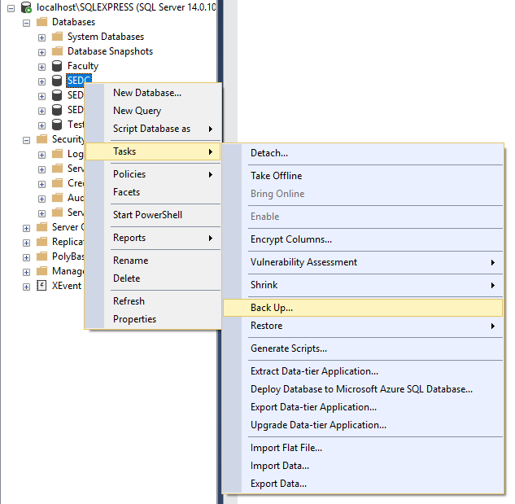
Database backups
Explain the concept of database backups
Try to backup SEDC database on your PC
Notes:
https://docs.microsoft.com/en-us/sql/relational-databases/user-defined-functions/user-defined-functions?view=sql-server-2017

Slide 20
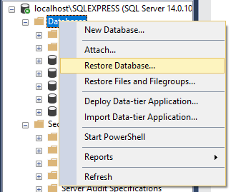
Database Restore
Explain the concept of database backups
Try to restore database on your SQL server

Slide 21
Permissions
Server logins
Create new login
https://docs.microsoft.com/en-us/sql/relational-databases/security/authentication-access/create-a-login?view=sql-server-2017
Map the login to specific roles
https://docs.microsoft.com/en-us/sql/relational-databases/security/authentication-access/server-level-roles?view=sql-server-2017
Map the login to specific databases
Test the new login
Notes:
https://docs.microsoft.com/en-us/sql/relational-databases/user-defined-functions/user-defined-functions?view=sql-server-2017

Slide 22
Knowledge check
Quiz, Discussion, Homework

Slide 23
Quiz
Can we have stored procedure without input parameters and with two output result sets?
a. Yes
b. No
Can we use temp tables inside stored procedure?
a. Yes
b. No
Can we use select statements inside error handling blocks?
a. Yes
b. No

Slide 24
Quiz
Can we have stored procedure without resultset on output?
a. Yes
b. No
What is the main difference between stored procedure and table valued function?

Slide 25
Homework

Slide 26
Homework requirement 1a/2
Create new procedure called CreateGrade
Procedure should create only Grade header info (not Grade Details)
Procedure should return the total number of grades in the system for the Student on input (from the CreateGrade)
Procedure should return second resultset with the MAX Grade of all grades for the Student and Teacher on input (regardless the Course)

Slide 27
Homework requirement 1b/2
Create new procedure called CreateGradeDetail
Procedure should add details for specific Grade (new record for new AchievementTypeID, Points, MaxPoints, Date for specific Grade)
Output from this procedure should be resultset with SUM of GradePoints calculated with formula AchievementPoints/AchievementMaxPoints*ParticipationRate for specific Grade

Slide 28
Homework requirement 2/2
Add error handling on CreateGradeDetail procedure
Test the error handling by inserting not-existing values for AchievementTypeID

